Slide 1
Internet Usage by Users

Slide 2
Introduction
RStudio
FIlter Data
Import Data
Merge datasets
Tableau
Visualizations
Conclude Questions
Internet Usage by users by different search engines (Google, bing, Yahoo!) by the top 12 Countries.

Slide 3
Every year the internet is becoming more useable by more people, so the demand on internet search engines will increase as the number of users increases.

Slide 4
Data Sources
Fields
List of Countries by number of Internet Users [1]
Desktop Search Engine Market Share[2] from Dec. 2011 to Dec. 2021
Country, Population, Search Engine, Number of users
[1] Source
[2] Source

Slide 5


Questions
Which countries in order has the most users using a search engine by Desktop?
What’s the total amount of users using every different kind of search engines like Google, Bing, Yahoo!, etc?

Slide 6
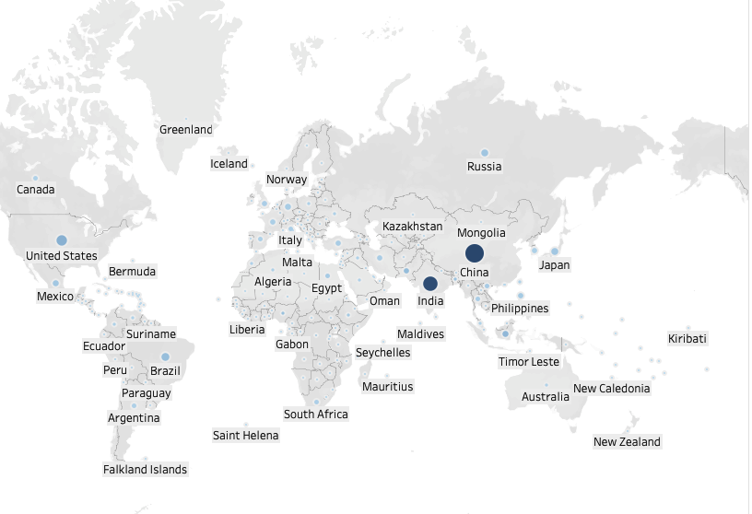
Map of Internet Usage
White
Gray
Black

Slide 7
Data Decisions
Choosing Countries.
I choose the top 12 countries not by how much internet users they had to their population, but by the highest number of internet users for that country.
Choosing which Search Engine
Based on the % of users on the search engine, I choose those who had a percentage more that 1%.

Slide 8
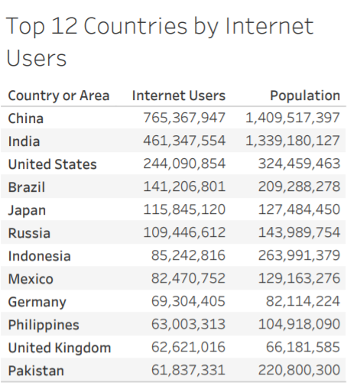

Slide 9
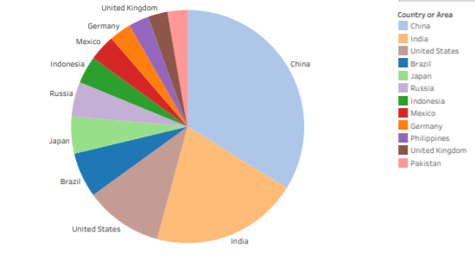
Pie chart: Countries by Internet Users.

Slide 10
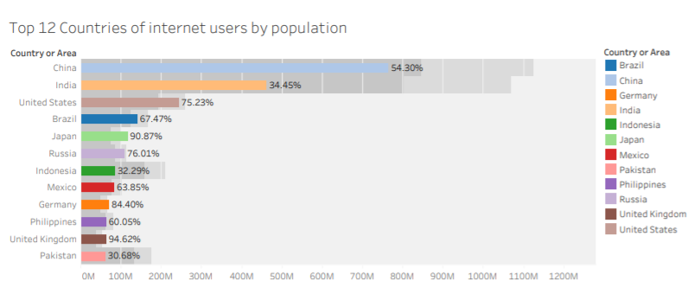

Slide 11
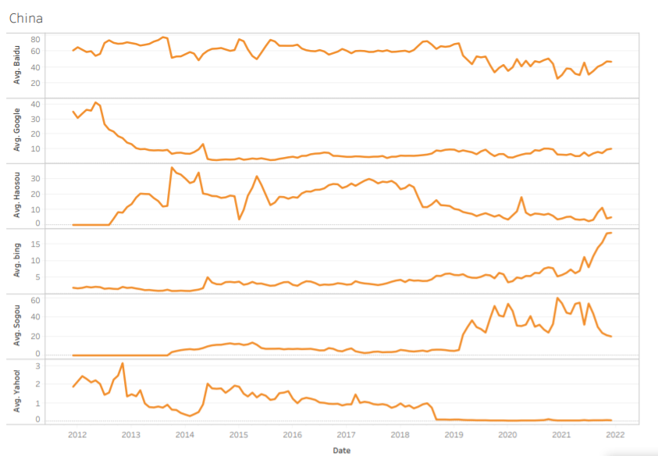
China

Slide 12
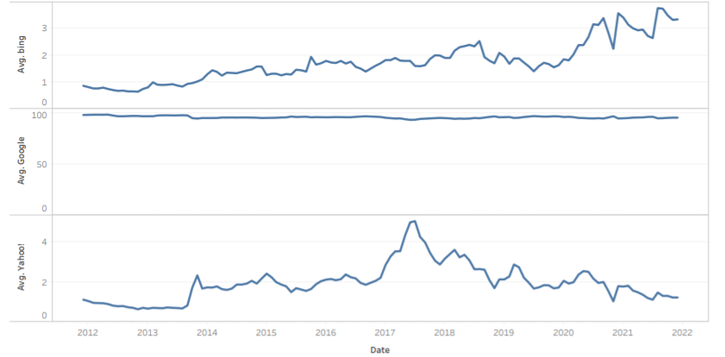
India

Slide 13
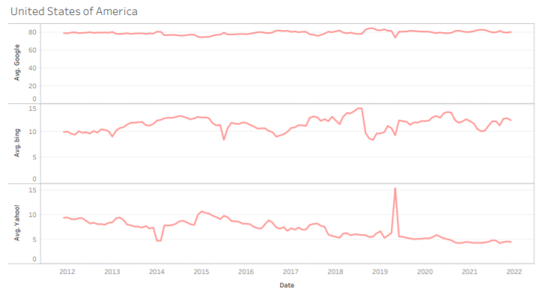
United States of America

Slide 14
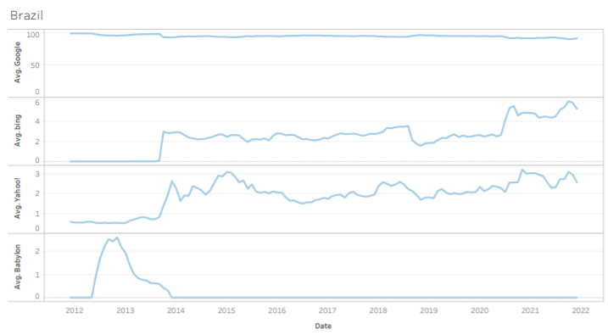
Brazil

Slide 15
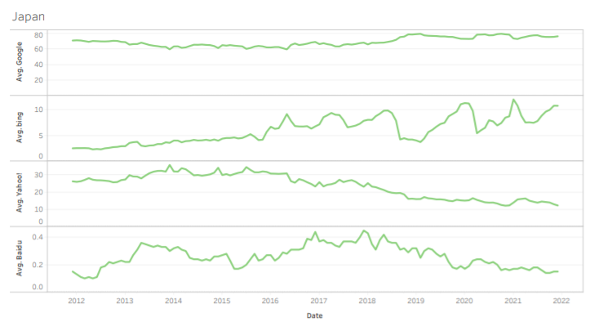
Japan

Slide 16
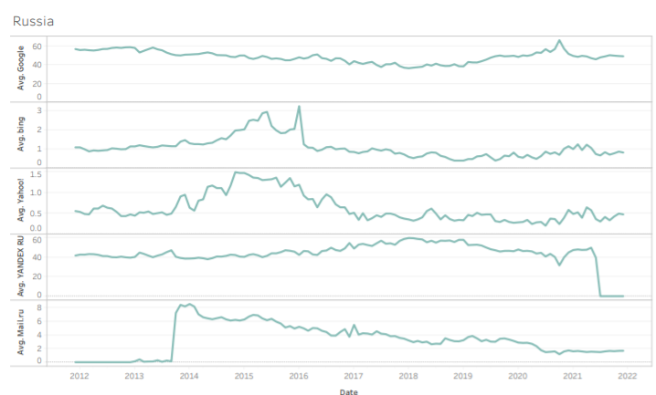
Russia

Slide 17
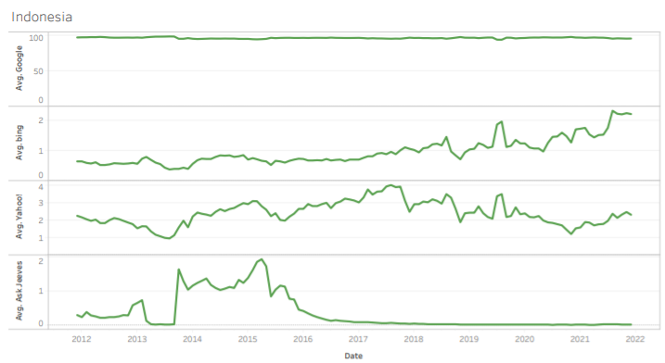
Indonesia

Slide 18
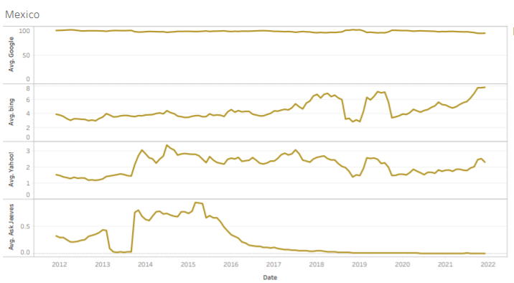
Mexico

Slide 19
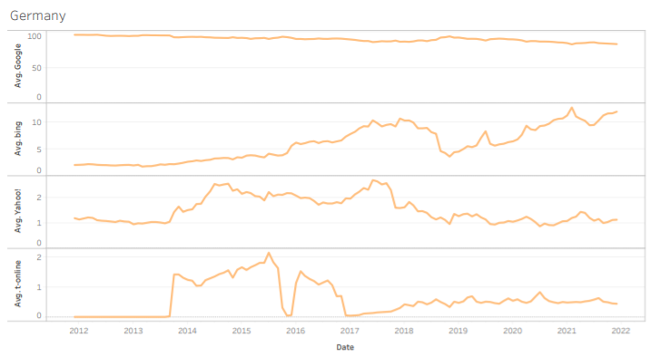
Germany

Slide 20
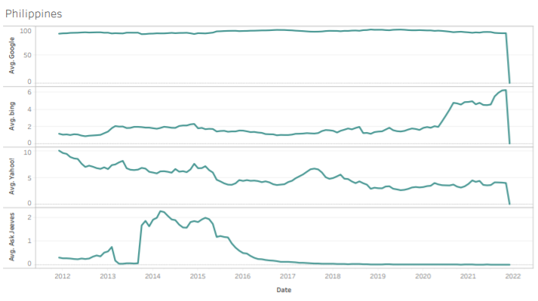
Philippines

Slide 21
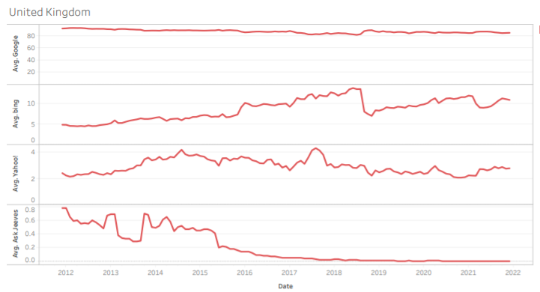
United Kingdom

Slide 22
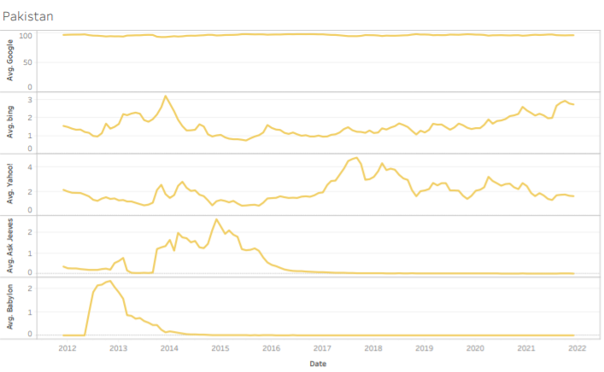
Pakistan

Slide 23
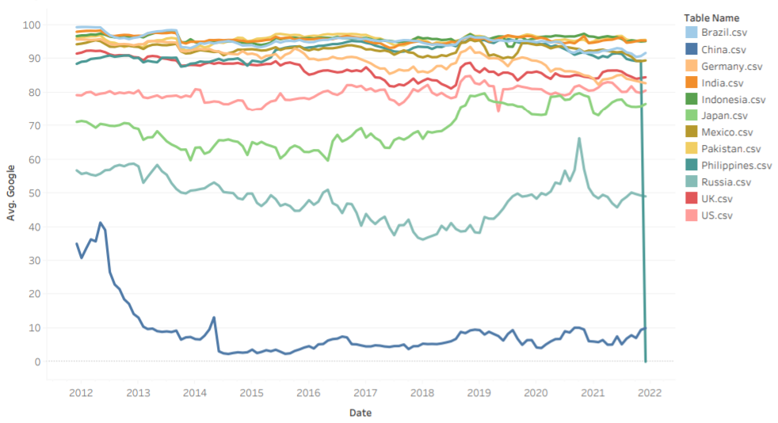
Google by all Countries

Slide 24
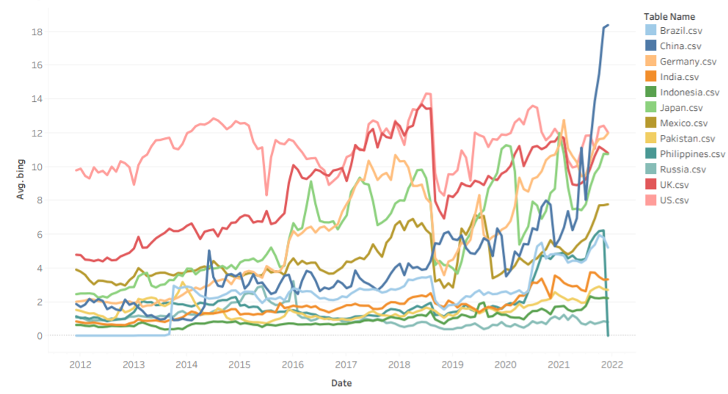
Bing by all Countries

Slide 25
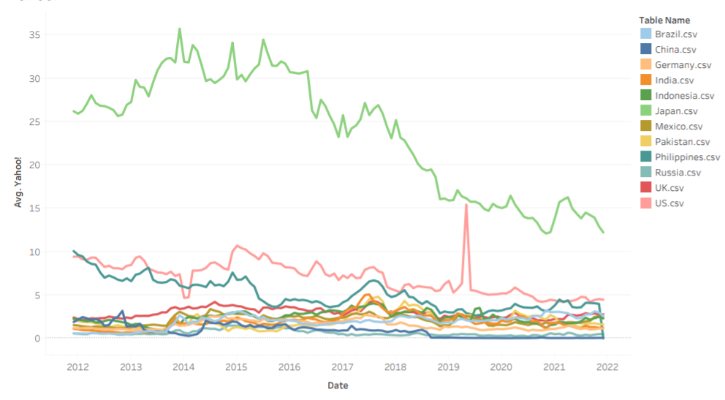
Yahoo! by all Countries

Slide 26
Thanks!
Any questions?

